Slide 1
Internet

Slide 2
internet
A system that connects billions of computers around the world.
A global network of hundreds of thousands of computers
Widely considered to be the defining technology of the beginning of this century

Slide 3
Web Protocols
Hypertext Transfer Protocol (HTTP) specifies the format of URLs as well as the procedure clients and servers follow to establish communication.

Slide 4
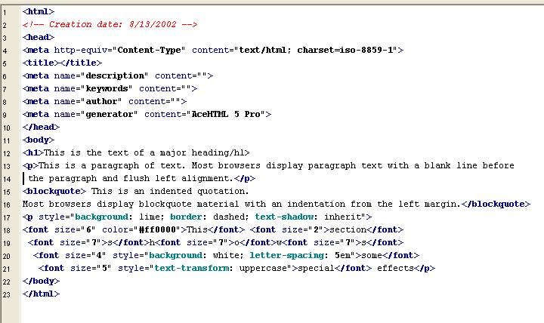
Web Page Design
HTML Document
Authors use a markup language called Hypertext Markup Language (HTML) to create Web pages.

Slide 5
Web site
A Web site is a collection of related Web documents that are made available to the public.
The index page, or home page, is the first page of a Web site.

Slide 6
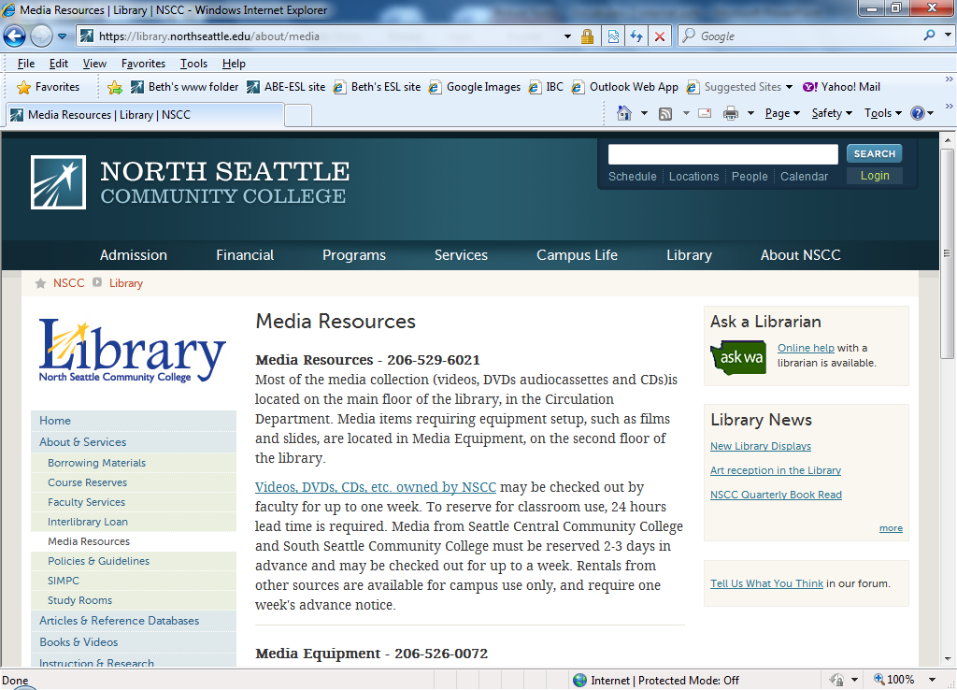
Web page
A page on the internet with information and links to other pages.

Slide 7
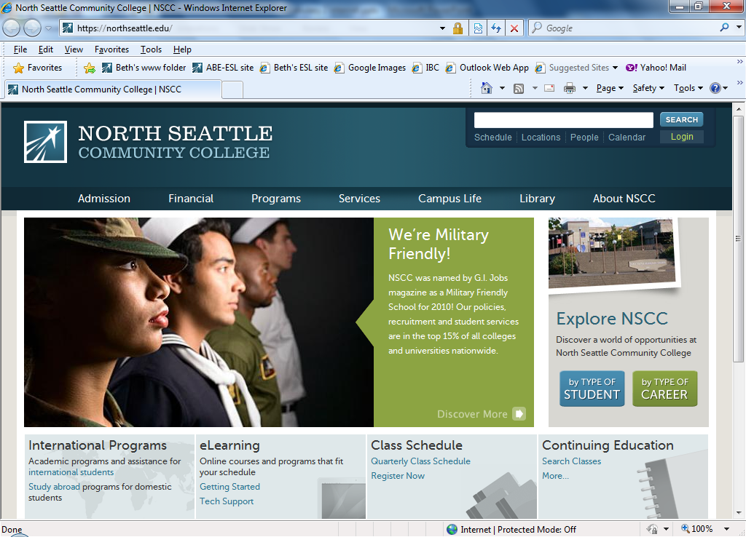
Home Page
The first/main page for a website.
Or the default start page is the page that appears when the web browser starts.
It can be customized.

Slide 8
Link
Words you can click on to open another page

Slide 9
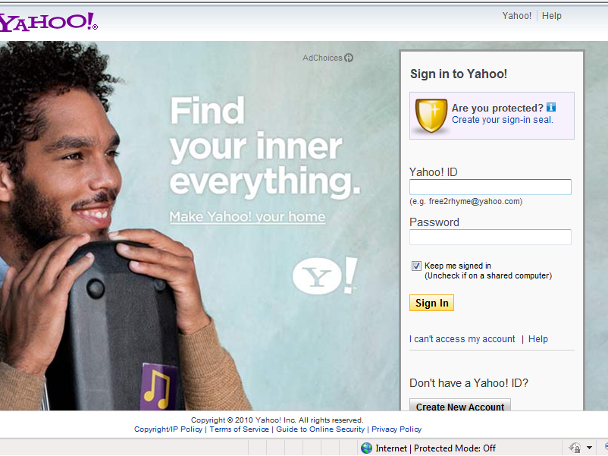
Text Box
A white box in which you can type one line of text (a couple of words)

Slide 10
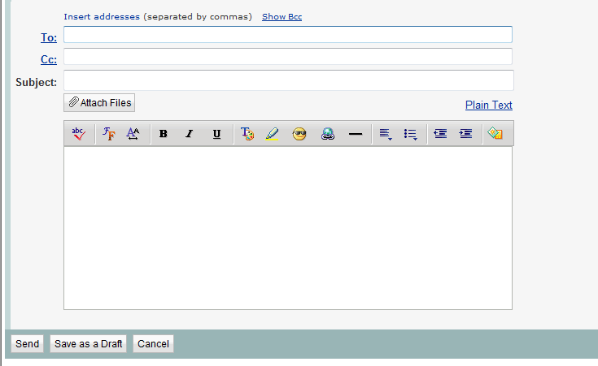
Text Area
A white box in which you can type several/many lines of text

Slide 11
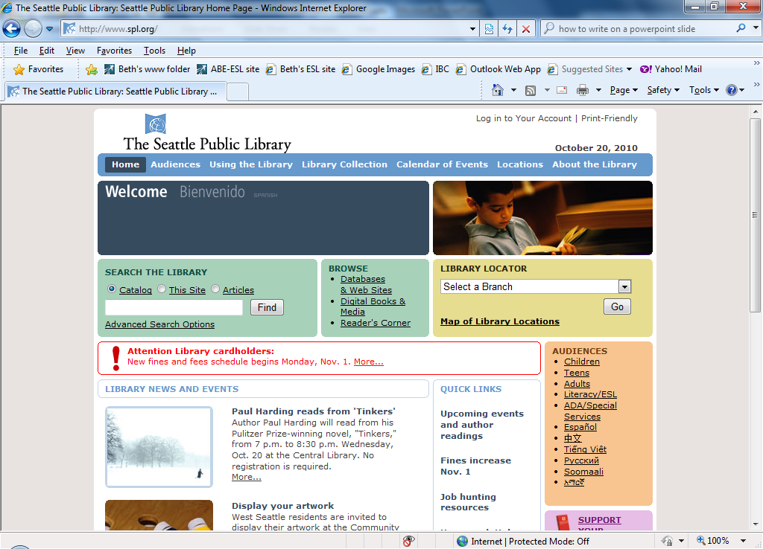
Drop Down Box
A text box with an arrow at the end; click on it to see a list of choices

Slide 12
Back
The icon that takes you to the last page you looked at

Slide 13


Browser
The program you use to open the internet (Internet Explorer and Mozilla Firefox are the most common ones)

Slide 14
search
To look for information

Slide 15
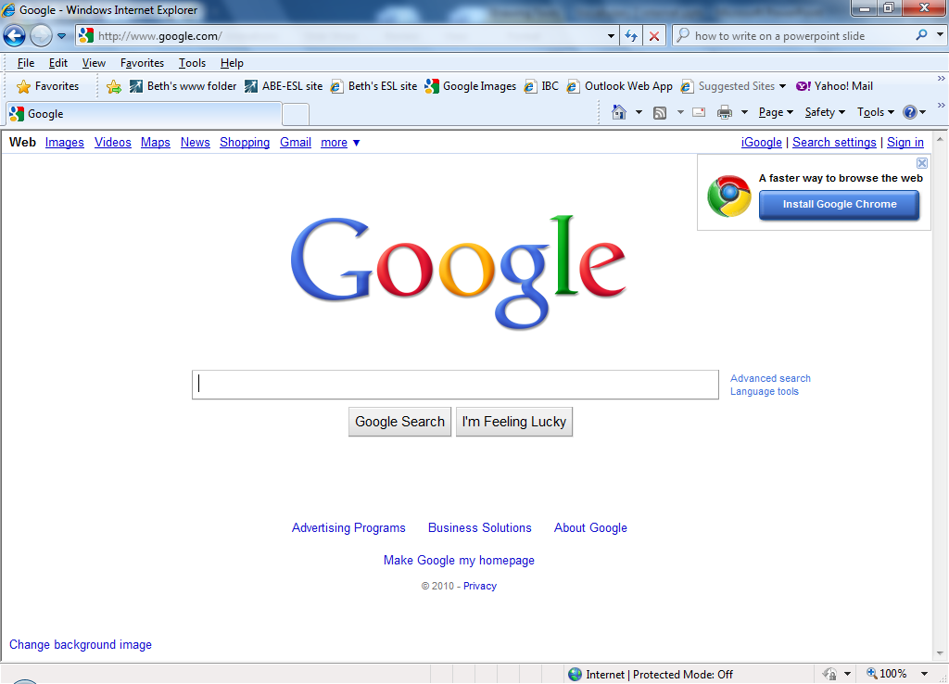
Search engine
A web site that searches the internet for information you want

Slide 16
Popular Search Engines
SEARCH ENGINE | URL
Lycos | www.lycos.com
Yahoo | www.yahoo.com
AltaVista | www.altavista.com
Google | www.google.com
Infoseek | www.infoseek.com
Excite | www.excite.com
AlltheWeb | www.alltheweb.com

Slide 17
Uniform Resource Locator (URL)
Website address

Slide 18
File Transfer Protocol (FTP)
A protocol for transferring files among computers.
FTP servers maintain collections of downloadable files
  Downloading can often be done anonymously, without logging in

